Slide 1
Overview of the IAEA’s
Technical Cooperation Programme
Presentation to the WTO, Geneva
Oscar Acuna, SH-TCEU2
Sandra Steyskal, PMO TCEU2
26 February 2009

Slide 2
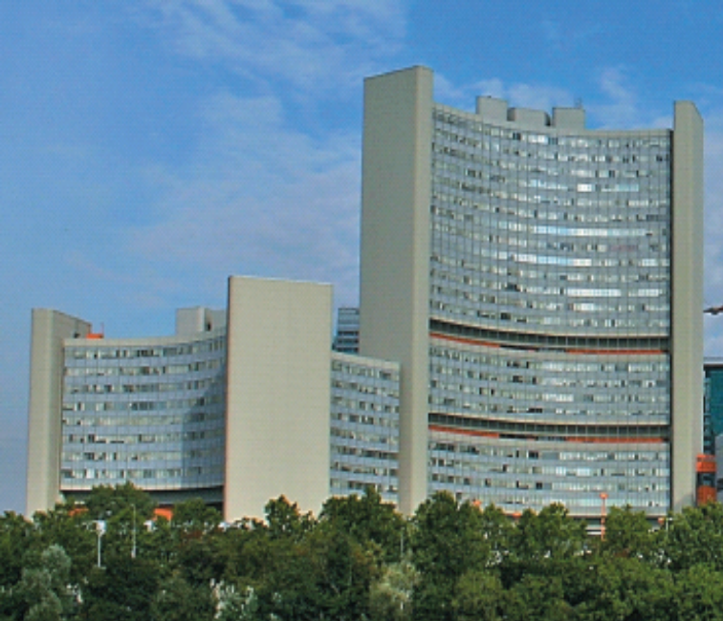
IAEA at a Glance
Founded in 1957
146 Member States
2300 professional and support staff
Headquarters in Vienna
2 scientific laboratories and research centres
Budget in 2009
  Regular Budget: € 291 m
  Technical Coop. Programme: US$ 85 m
  Extra-budgetary Contributions (estimate): US$ 49 m
Notes:
The IAEA has a staff of about 2,200, with headquarters in Vienna, offices in New York, Geneva, Toronto, and Tokyo, and scientific laboratories in Monaco and Austria. The IAEA has 133 member states; 35 of which make up its Board of Governors.
The Agency is often referred to in the media as the world’s “nuclear watchdog”—and many people associate it with the inspections of nuclear facilities and activities in Iraq, Iran, North Korea, and Libya in the search to uncover weapons of mass destruction. In fact, the work of the Agency goes far beyond this watchdog—or nuclear verification—role.

Slide 3
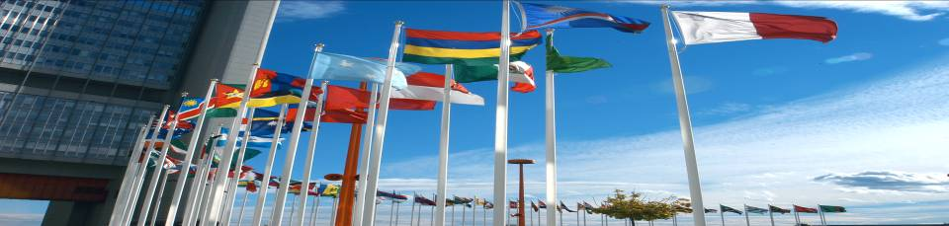
The IAEA and its Mission
Maximizing the contribution of nuclear technology to the world
while verifying its peaceful use

Slide 4
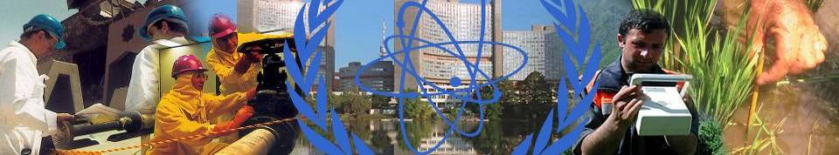
IAEA Mission and Activities: Three Pillars
Safeguards & Verification
The IAEA performs an indispensable role in furthering non-proliferation through verifying States' commitments regarding the peaceful use of nuclear energy
Safety & Security
The IAEA works to protect people and the environment from harmful radiation exposure.
Science & Technology
The IAEA works to foster nuclear applications in Member States.
Notes:
Safeguards & Verification: The IAEA works to prevent the further spread of nuclear weapons
Safety & Security:
Science & Technology: The IAEA works to mobilize peaceful applications of nuclear science and technology to developing countries.
I will go into more detail about these core areas of the Agency’s throughout this presentation

Slide 5
IAEA Organisational Chart
Director General
Technical Cooperation
Nuclear Energy
Prog. Support & Coord.
Africa
Asia
Latin America
Europe
Nuclear Power
Nuclear Fuel Cycle & Waste Tech.
Nuclear Safety and Security
Management
Nucl. Inst. Safety
Radiation, Transport & Waste Safety
Budget & Finance
General Services
HR
Conference & Doc. Services
IT
Public Information
Nuclear Sciences & Applications
Safeguards
SEIB
Human Health
Marine Env. Lab, Monaco
FAO & Agriculture
Physical & Chemical Sciences
Concepts & Planning
Operations A
Operations B
Operations C
Information Management
Technical Support

Slide 6
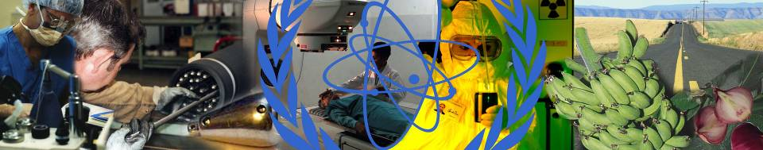
Technical Cooperation Department
Interface between Member States and the Secretariat for technical cooperation assistance
Regional and country focus rooted in policy priorities of Member States
Programme coordination, implementation and management with input from technical departments
Notes:
Promoting Science & Technology
The IAEA is working to to fighting poverty, sickness, and pollution of the earth's environment, and to other global "Millennium Goals" for a safer and better future. Some examples of this are listed above. Nuclear technologies reaches into almost every aspect of our daily lives. A few facts are:
Nuclear power generates about 16 percent of the world’s electricity;
Someone receives radioisotope treatment for medical diagnosis every third second; that is 35,000 persons every day;
3 million persons are treated with radiotherapy each year against cancer;
40 countries now use irradiation to improve the hygiene, safety and quality of food;
Radiation is used in scores of industrial applications: sterilizing syringes and other hospital supplies; testing the quality of steel for cars and trucks; and checking for production flaws in airplane engines.

Slide 7
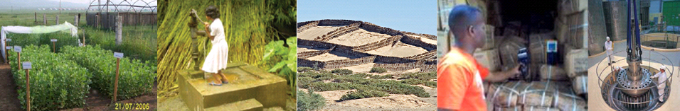
Selected TC Interventions
Improving Human Health
Supporting Agriculture and Rural Development
Advancing Water Resource Management
Addressing Environmental Challenges
Providing Analysis for Sustainable Energy Development
Promoting Safety and Security

Slide 8
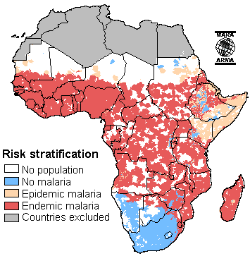
Improving Human Health
Control of communicable diseases, including HIV/AIDS and detection of drug-resistant strains of Malaria and Tuberculosis
Advance cancer therapy
Expand technical capabilities in nuclear medicine diagnosis
Improve nutritional status of children and women
Assess nutrition intervention programmes related to HIV/AIDS

Slide 9
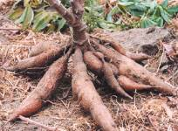
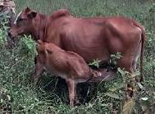
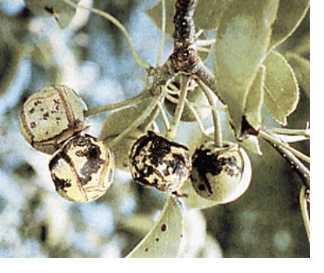
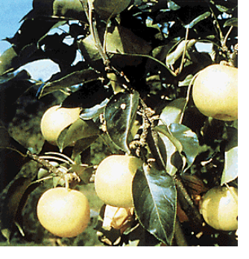
Supporting Agriculture and Rural Development
Establish tsetse-free zones
Improve crop productivity
Combat agricultural pests
Improve animal health
Promote livestock production

Slide 10
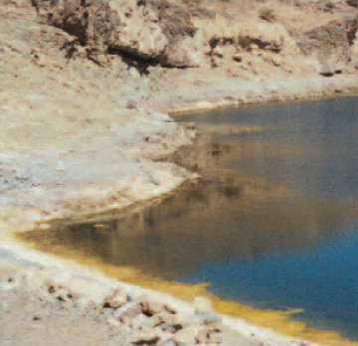
Advancing Water Resource Management
Map groundwater resources in Africa (Hydrology Atlas)
Develop integrated management schemes for water resources
Study vulnerability to pollution
Investigate sea water intrusion
Strengthen capabilities for hydro geochemical mapping
Investigate dam and reservoir leakages and safety
Notes:
More examples

Slide 11
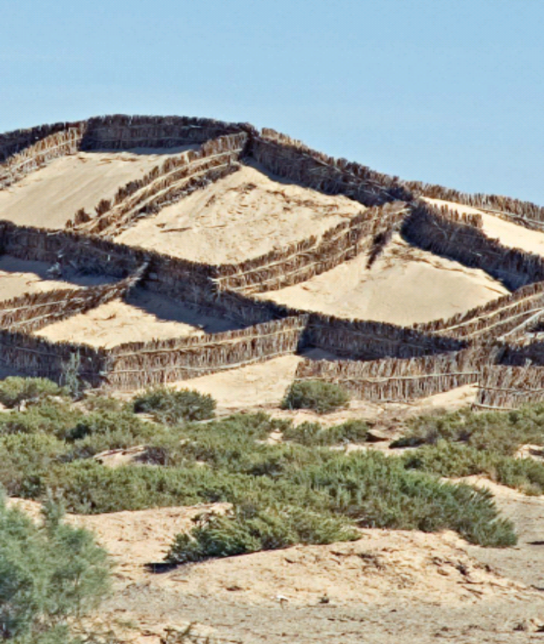
Addressing Environmental Challenges
Improve soil conservation and efficient land and water management
Combat desertification in the Sahel
Analyse status of land and water degradation
Detect and study groundwater and air pollution
Manage and remediate contaminated zones
Improve coastal zone management

Slide 12
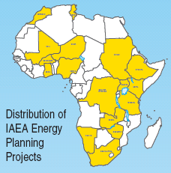
Promoting Sustainable Energy Development
Build capacities to manage the development of the energy sector
Transfer IAEA tools for energy demand forecasting, integrated energy planning, and least-cost electricity system expansion planning
Train national energy system specialists to independently conduct country studies

Slide 13
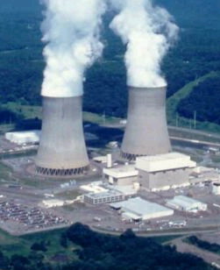
Promoting Safety and Security
Upgrade nuclear infrastructure
Prepare for and respond to emergencies
Strengthen nuclear safety and radiation regulation
Build capacities:
  Legislative frameworks, regulatory infrastructure, operational safety, safety assessment, infrastructure preparation, human resource development, management systems, plant life management, radiation protection, waste management, emergency preparedness and response
Notes:
The World at a Glance
The present situation in nuclear power generation throughout the world is extremely varied. In the 30 countries that have nuclear power generation capacity, the percentage of electricity coming from nuclear reactors ranges from 78 % in France to just 2 % in China.
All told, as of March 2008, there are 439 nuclear power plants around the world, while 35 more are under construction. The USA has the most with 104, France is next with 59, then Japan with 55 and Russia has 31 and seven more under construction.
The expansion in nuclear power generation is centered in Asia. A total of 20 of the 35 plants under construction are in Asia, while 28 of the last 39 plants connected to the grid are also in Asia.

Slide 14
What is the IAEA TC Programme?
..a mechanism for pooling in-house technical resources
DG Offices
Budget and Finances
Food &
Agriculture
Human
Health
Physical &
Chemical
Sciences
TCP
Environment
Studies &
Monitoring
Nuclear
Safety
Nuclear
Power
Nuclear
Security
Nuclear
Fuel Cycle
&
Waste
Radiation
Transport
Waste
Safety

Slide 15

What is the IAEA TC Programme?
..a bridge between Member States and the Agency
IAEA
TC Department
National Liaison Officers
Permanent Missions
Counterparts
IAEA
Technical Departments

Slide 16
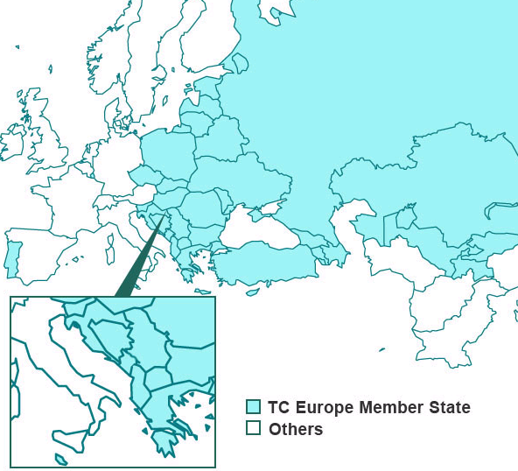
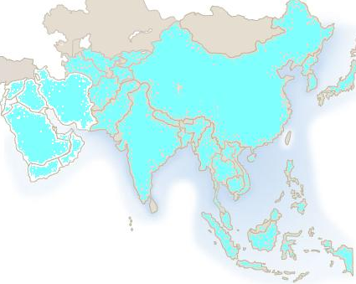
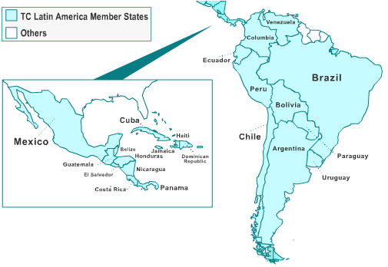
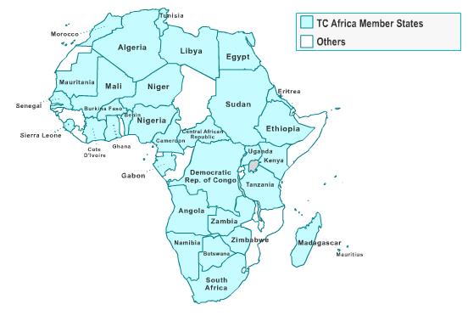
110 TC Member States from 4 Regions participate in the TC Programme
EUROPE
LATIN AMERICA
ASIA
AFRICA

Slide 17

TC Programme for 2009-2011
480 National projects
150 Regional projects
TCF Budget = $ 250 Million
Forecasted EBC = $ 240 Million

Slide 18

Distribution of 2009-2011 TC Programme by field

Slide 19
DESIGNING NATIONAL PROGRAMMES
Country Programme Framework (CPF)
Programme cycle:
  Project concepts (submitted by Member State)
  Project designs (IAEA-MS team work)
  Implementation and performance assessment
A programming tool that provide a frame of reference
for TC between the IAEA and its MS in the medium term (4-6 years).
Concise frame of main national development needs/problems
that can be addressed using nuclear science and technology.

Slide 20
DESIGNING REGIONAL PROJECTS
European Regional Profile (ERP)
Used as a reference toolbox for screening and designing priority regional projects
Identifies 4 main sector for regional cooperation plus 1 cross-cutting sector
The ERP is a programmatic tool that includes an analysis of
the present situation in the region and trends for regional
cooperation, as well as a detailed discussion of the
priorities areas of technical cooperation at the regional level

Slide 21
Regional Focus of TC Programme in 2008
TC Africa
  Human Health, Food and Agriculture, Nuclear Science
TC Asia and the Pacific
  Human Health, Radiation Technology, Safety, Food and Agriculture
TC Europe
  Human Health, Radioactive Waste Management, Safety, Sustainability & Knowledge preservation
TC Latin America
  Human Health, Food and Agriculture, Radiation & Transport Safety

Slide 22
Thank You!
Mr. Oscar Acuña
TC Europe
T +43 1 2600 25985
O.Acuna@iaea.org
http://www-tc.iaea.org/tcweb/regionalsites/europe/default.asp

